Slide 1

Crimes in Philadelphia
Raj Patel, Hong Son, Kunal Sharma
Notes:
Raj

Slide 2

Agenda
Team Introduction
Problem Statement
Target Audience
Github
Datasets
Visualizations & Interpretations
Machine Learning
Model Optimization
Outcomes
Limitations
Future Work
Work Cited
Questions

Slide 3



Team
Hong Son
Education: BS/MS Data Science Drexel University (in-progress)
Occupation: Student
Skills: Data engineering, machine learning, and presenting.
Kunal Sharma
Education: MS Data Science Drexel University (in-progress)
Occupation: Student
Skills: Data engineering, machine learning
Raj Patel
Education: BS/MS Data Science Drexel University (in-progress)
Occupation: Student
Skills: Data cleansing, statistical analysis, and documentation.
Notes:
Each person introduces each other

Slide 4



Problem Statement
Philadelphia ranks above the national average in terms of crimes (especially violent crimes)
Ranks second in murder rates among the 10 largest cities in 2020
It has been included in real estate analytics company NeighborhoodScout's "Top 100 Most Dangerous Cities in America" list every year since it has been compiled
Our proposed solution is to create multiple models that can predict and classify the type of crime. This can also help provide community insights on how to make improvements to reduce the crime from occuring in the first place.
Notes:
Raj
https://6abc.com/philadelphia-crime-homicide-stats-philly-murders/6351850/

Slide 5
Intended Audience
Law Enforcement Officials (Philadelphia Police Department)
Equip law enforcement with intelligence to effectively combat crime proactively
City Officials
Help officials identify areas and allocate resources to monitor crime
Citizens
Educate citizens about crimes most likely to occur in area
Notes:
Raj

Slide 6

Github
Folder Structure
https://github.com/hongson1218/Crime-in-Philadelphia/tree/master/Winter%2020-21
Crime
Presentations
Reports
Weather
Parking Violations
Notes:
Hong

Slide 7


Datasets
Philadelphia Crime Data:
Published by OpenPhillyData
Dates from 12-31-05 to 03-22-17 (majority of the dates are from 2006-2016)
Attributes include the district number, sector, dispatch date, dispatch time, location, general code, descriptions of the crime, and locations
There are 14 total columns and ~2,237,605 in this dataset.
Philadelphia Weather Data:
Published by Pennsylvania State Climatologist
Dates from 2007 to 2018
The dataset includes the temperatures in Fahrenheit, the max and min temperature, environment information, wind, and precipitation.
The data was formatted from PDF files and a dataset was formed [~4,000 rows and 14 columns].
Notes:
Hong

Slide 8

Datasets
Parking Violations:
Published by OpenPhillyData
Dates from 2012 to 2017
Attributes include the zip code, date, state, violation, location, year
There are 14 total columns and ~5,760,749 in this dataset.
Notes:
Hong

Slide 9
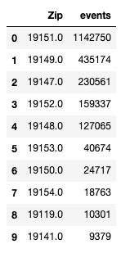
Top 10 - zip codes
What are the top 10 zip codes where crime occured?
From our analysis we can see that the top 10 zip codes are [in order]
19151, 19149, 19147, 19152, 19148, 19153, 19150, 19154, 19119, 19141
Overbrook, Oxford Circle, Bella Vista|Wharton, Rhawnhurst, Pennsport, Tank Farms and Refineries|Eastwick, Cedarbrook|Mount Airy, West Torresdale,
Notes:
Hong

Slide 10
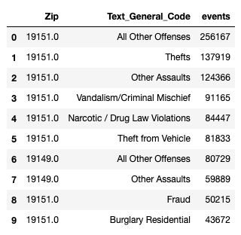
Top 10 - Zip Code & Crime Type
What are the top 10 crimes that occured with crime Type factored in?
From our analysis we can see that there are multiple cases of crimes at 19151. Two instances with crime in 19149 also made the counts.
Notes:
Hong

Slide 11
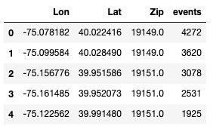
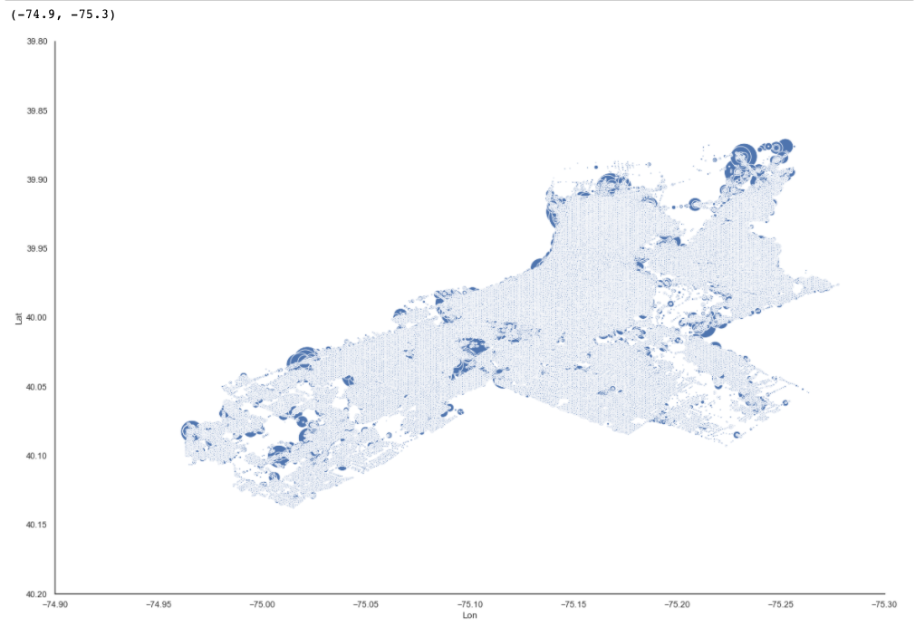
Regions with Most Crime
Regions with the most crime?
We found it interesting that when we consider Lon, Lat, and Zip that the most events happened in 19149.
Notes:
Hong

Slide 12
Machine Learning (Applications)
Predicting the Crimes based on Text General Code (Type of Crime)
Predicting the Top 5 Crimes that Occured
Optimization - Predicting the Crimes based on Grouping
Predicting type of Crime that is ‘Non-Violent’ or ‘Violent’
Notes:
Kunal

Slide 13
ML - Models Used
Supervised Learning
KNN
Decision Tree
Extra Trees
Random Forest
Logistic Regression
Notes:
Kunal

Slide 14
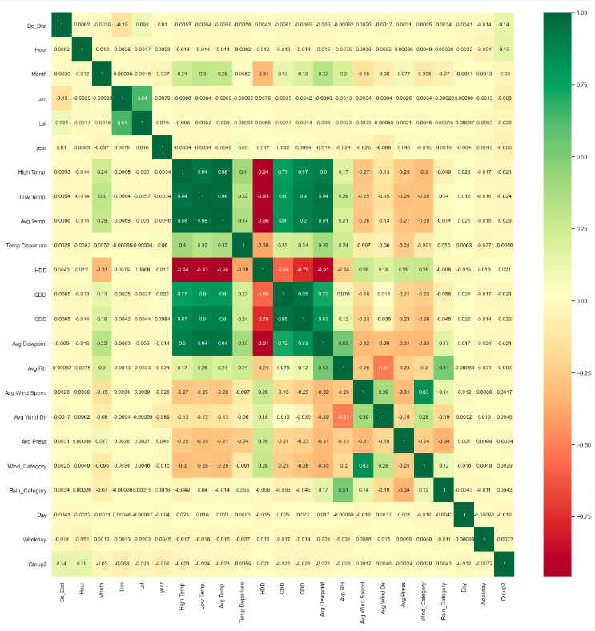
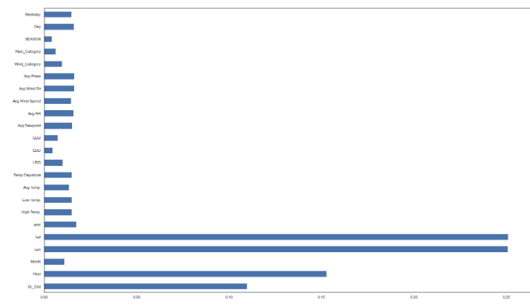
ML - Feature Selection
We found that ['Lon', 'Lat', 'Hour'] were the attributes that mostly correlated to the type of crimes.
Notes:
Kunal

Slide 15
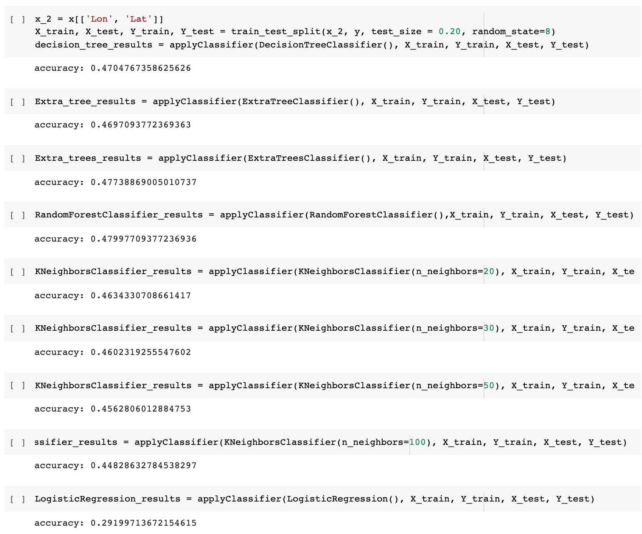
ML (Predicting Top 5 Crimes) - Results
A models ranged 29-47% accuracy. We decided to optimized the models by grouping the crimes.
Notes:
Kunal

Slide 16
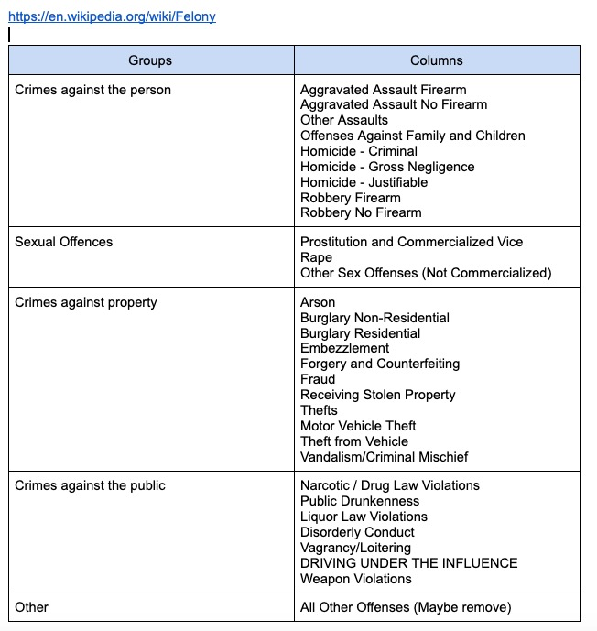
ML - Optimization
In order to enhance the performance of the model, crimes were grouped to reduce noise.
There were 30+ types of crimes before we grouped them into broader categories
The new categorization reduced the crime type count to only 5 variations
Notes:
Hong

Slide 17
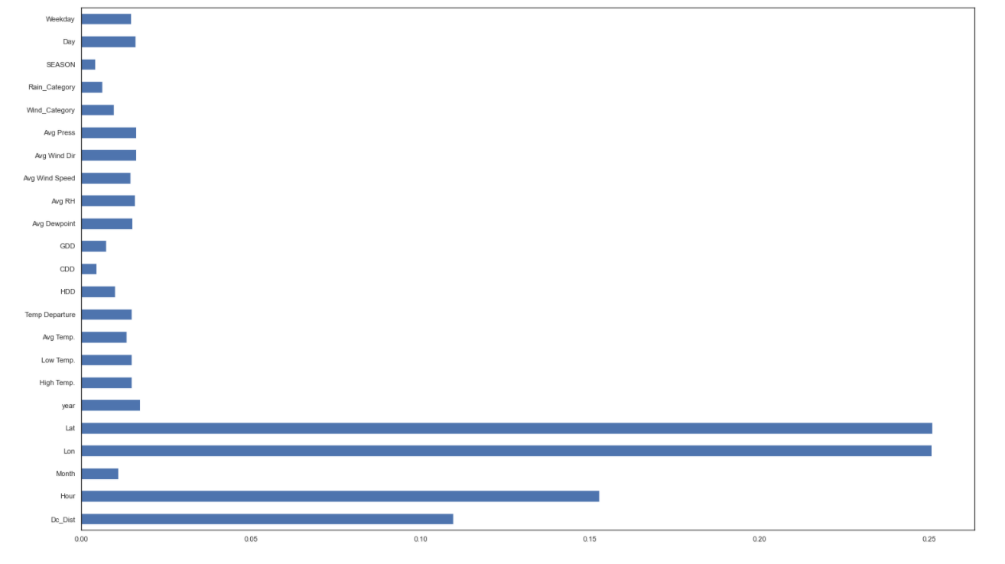
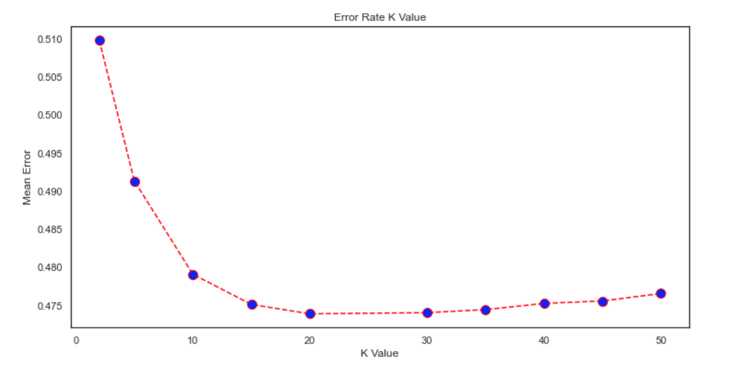
ML Optimization - Feature Selection
We found that ['Lon', 'Lat', 'Hour'] were the attributes that mostly correlated to the type of crimes.
Using the elbow method, we used Number of Neighbors as 20
Notes:
Hong

Slide 18
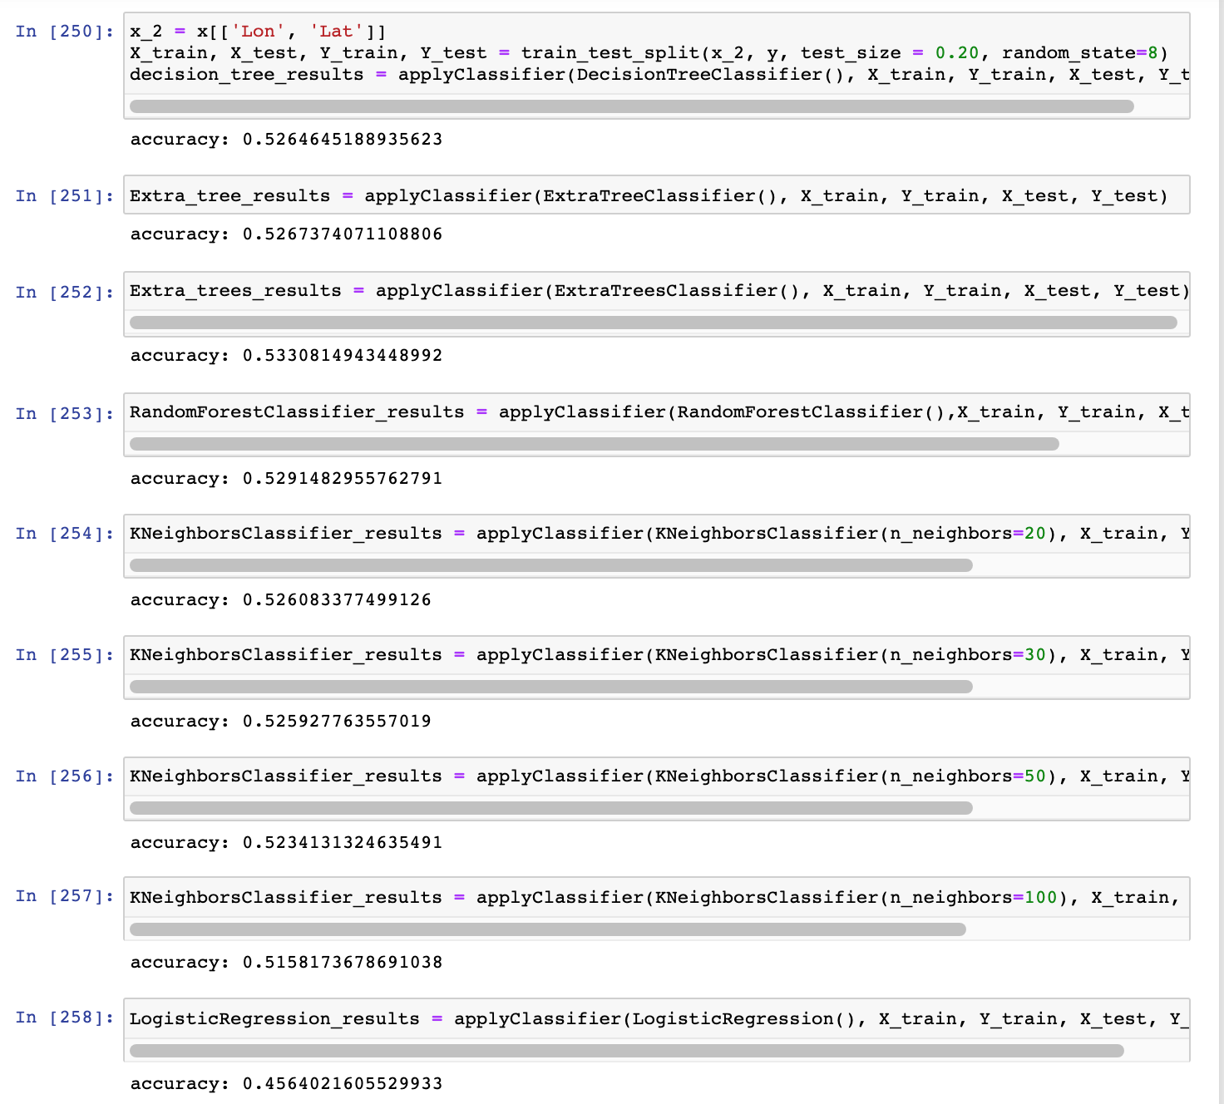
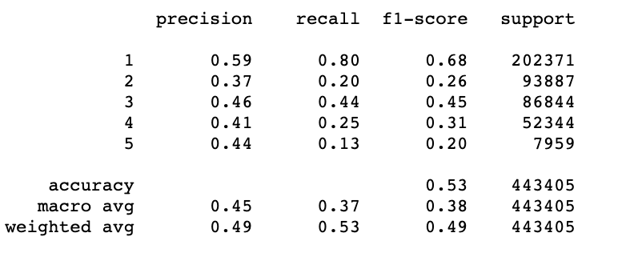
ML Optimization - Results
The models ranged from 45-53% accuracy. We see from the classification report that we get very low precision, recall, and f1-score for classes outside of class 1.
Notes:
Hong

Slide 19
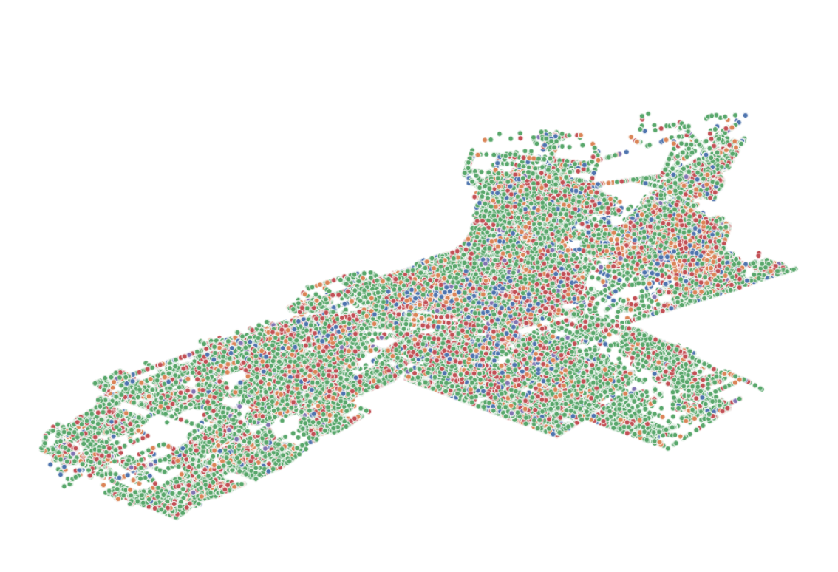
ML Optimization - Justification
A majority of the nearest neighbors or latitude points will be classified as green or class 1.
Notes:
Hong

Slide 20
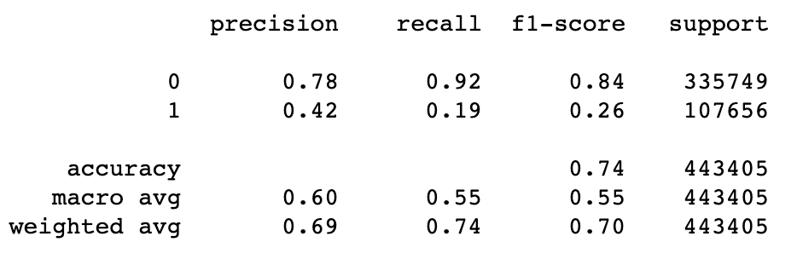
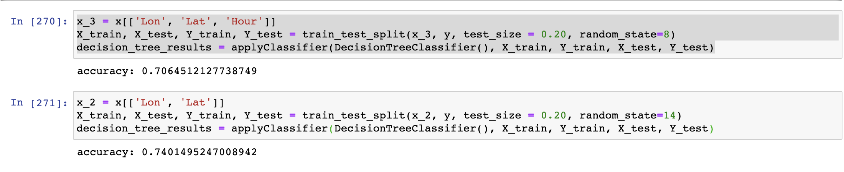
ML (Violent and Non-violent Crimes) - Results
The accuracy increased significantly as we grouped the crimes in violent and non violent.
Notes:
Kunal

Slide 21
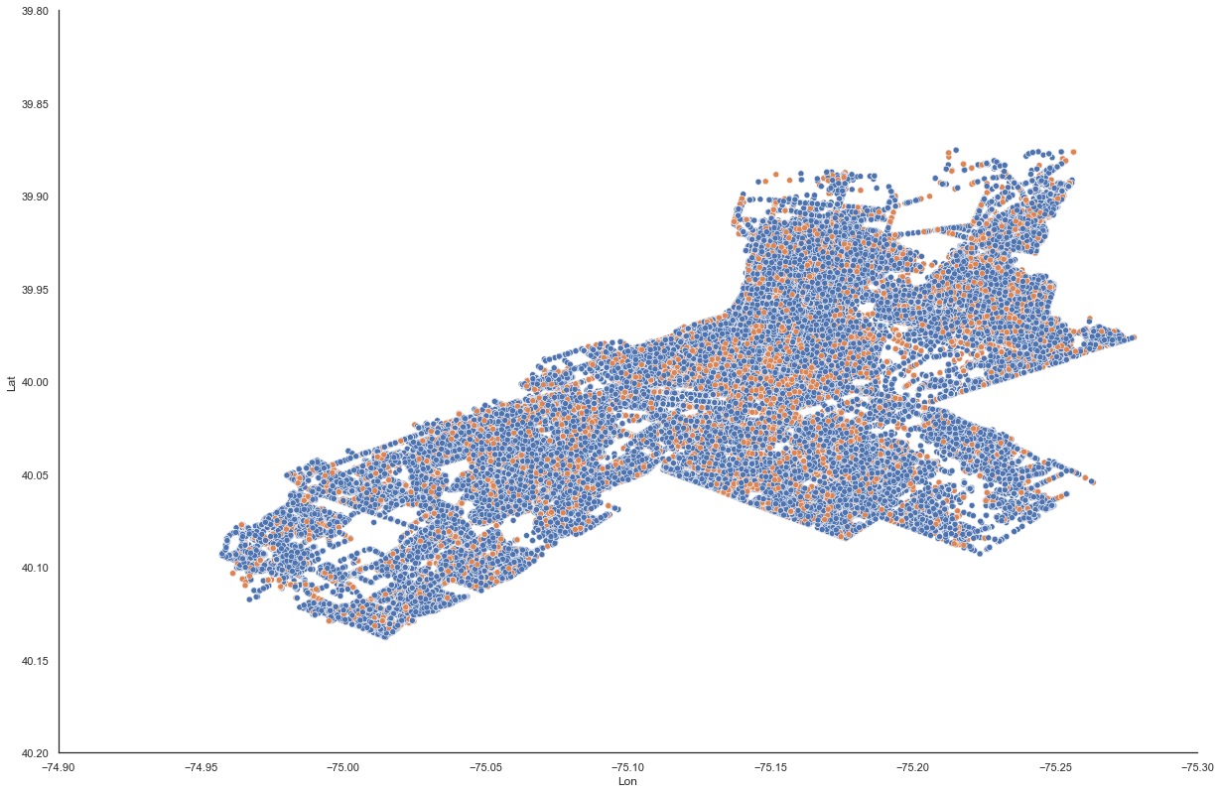
ML Optimization - Justification
A majority of the nearest neighbors or latitude points will be classified as blue or class 0.
Notes:
Kunal

Slide 22
Limitations
Lack of helpful attributes to move the needle and improve model performance
We tried to integrate more datasets, but it was very difficult to integrate other datasets.
Lack of existing research in this area
Very little work on optimization of models (class imbalances, bias, ambiguity)
Notes:
Raj

Slide 23
Lessons Learned
Before working on machine learning, it’s important to hone in on the dataset and focus on conceptualizing problems to be addressed.
Machine learning may not work well with every dataset
Grouping the crimes improved the model but not by much
It’s important to make pivots as needed in response to unaccounted issues that may arise.
Notes:
Raj

Slide 24
Future Work
Forecasting Number of Crimes
Create a Medium article
Notes:
Kunal
Suggestions:
Using other groups’ project data (Housing)
Mondays - Fridays : Anytime Tue, Wens, Thursday (Kunal) or 2-4 other days
Any time after 5pm
3-4 4-5 or 6 ish
Possible Questions:
If a given person lives in a an area - estimating prices (insurance rates)?
Regression model for how much insurance rates might be? How accurate is model?
K nearest neighbors on housing prices? Good estimates?

Slide 25
Work Cited
Chirico, M. (2016). Philadelphia Crime Data. Retrieved 2020, from https://www.kaggle.com/mchirico/philadelphiacrimedata.
Cuellar, D. (2020, August 04). Philadelphia Among Top Deadliest Cities in U.S. This Year. Retrieved November, 2020, from 12345https://6abc.com/philadelphia-crime-homicide-stats-philly-murders/6351850/
Neighborhood Scout's Most Dangerous Cities - 2020. (2020, January 22). Retrieved November, 2020, from 11111https://www.neighborhoodscout.com/blog/top100dangerous
The Pennsylvania State Climatologist. (2020). Retrieved 2020, from 11111http://www.climate.psu.edu/data/city_information/index.php?city=phl&page=dwa&type=big7
Notes:
Raj

Slide 26

Questions?

